Slide 1
Roadmap to the Revised
Rental Assistance Demonstration (RAD) Notice:
PIH Notice 2012-32/ Housing Notice 2017-03, REV-3
February 23, 2017

Slide 2
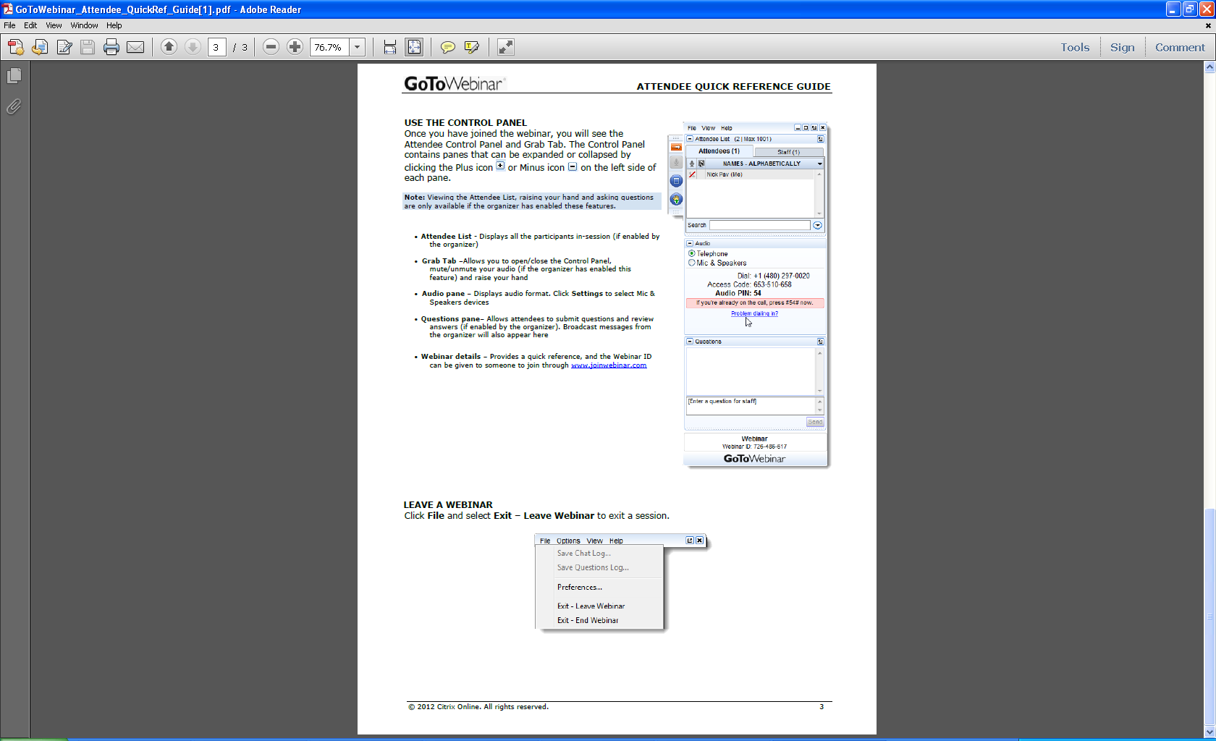
Welcome
Ask questions! Here’s how:
  “Raise your hand” by clicking on the hand icon and the presenter will un-mute your line so you can ask your question live
  Note: To do this, you MUST call the dial-in number shown
  on your attendee control panel and input the audio PIN shown, which is unique to each attendee
  Send in questions via the “Question” feature or email them to rad@hud.gov; answers to those questions will be provided after the webcast and posted to the FAQs

Slide 3
Why a revised notice?
    This revision builds on the program’s success and lessons learned in order to ensure that the program’s pace continues and more properties can be preserved and transformed.
    First Component (training held on 2/21/17)
      Simplify certain program requirements
      Create new flexibilities to make more conversions feasible
      Strengthen resident notification
    Second Component
      Improve rent-setting options

Slide 4
Section II: Mod Rehab Conversions
Section III: Rent Supplement, and Rental Assistance Payment Project Conversions
RAD Notice – Revision 3

Slide 5
RAD Program Structure
Rent Supplement
Rental Assistance Payment
Public Housing
Section 8 Moderate Rehabilitation
McKinney Vento Mod Rehab Single Room Occupancy (SRO)
RAD for Public Housing
“1st Component”
185,000 Unit Cap
RAD for Legacy Assisted Housing
“2nd Component”
No-Cap
PBRA
PBV
PBRA
PBV

Slide 6
Implementation
All conversions under the second component are bound by the notice in effect at the time of the conversion request
Projects that have not yet closed may request HUD approval to convert under the terms of the revised Notice

Slide 7
PBV Project Cap
Eliminates cap on the Number of PBV Units in Each Project (see section 1.6.A.2).
  The limit on the cap on the number of PBV units in a project is eliminated. (Previously, it had been increased from 25% to 50% under RAD for Converting Projects.)
  Related provisions related to exceptions to project cap are also eliminated by this revision to the Notice.
  Requirement to describe services (previously needed for exception to project cap) is eliminate
  Revision aligns with reforms made under HOTMA

Slide 8
Using SAFMR for Conversions to PBRA
Small Area Fair Market Rents (see sections 2.6 and 3.6)
  For conversions to PBRA and with HUD approval, the Project Owner may use the Small Area FMR (SAFMR) in the calculation of contract rent cap.
  Where HUD has approved the use of Small Area FMR by project, the Small Area FMR will continue to serve as the applicable FMR when determining the rent cap when adjusting rents.

Slide 9
FMR Rent Cap for Conversions to PBRA
Mod Rehab, Rent Supp, and RAP conversions to PBRA may achieve rents between 110 percent and 120 percent of FMR (up to the statutory maximum), if justified by comparable market rents, if the project:
preserves project-based rental assistance in communities with high percentages of rent-burdened households and where it is particularly hard to utilize tenant-based assistance,
serves to expand housing opportunities in communities with poverty rates less than 30%, and/or
supports revitalization activities that are resulting in material private investment in the surrounding neighborhoods.

Slide 10
Mod Rehab and SRO Market-based Rent-Setting for PBRA Conversions
Initial contract rents are no longer limited to the Mod Rehab contract rents. Instead, rents will be set at the lesser of:
a) comparable market rent as determined by an RCS or
b) 110% of the FMR less utility allowances

Slide 11
Applicable FMR for Mod Rehab SROs
Authorizes the use of the zero bedroom (efficiency) FMR for SRO units for initial and re-determined rents, rather than 75 percent of the efficiency FMR, which is the existing SRO standard (see sections 2.5.G, and 2.6.C and D)

Slide 12
Summary of Contract Rent Provisions
*New Provisions in Red*
 | From Mod Rehab / SRO | From Rent Supp / RAP
PBRA | Contract Rents set at comparable market rents (determined by a Rent Comparability Study) up to 110% of FMR Owners may request to use Small Area FMR SRO Units use Efficiency FMR With HUD approval, and if supported by comparable market rents, contract rents may be set up to 120% of FMR | Contract Rents set at comparable market rents (determined by a Rent Comparability Study) up to 110% of FMR Owners may request to use Small Area FMR With HUD approval, and if supported by comparable market rents, contract rents may be set up to 120% of FMR
PBV | Contract Rents set at market rent levels (determined by PHA’s Rent Reasonableness analysis) up to 110% of FMR SRO Units use Efficiency FMR | Contract Rents set at market rent levels (determined by PHA’s Rent Reasonableness analysis) up to 110% of FMR

Slide 13
Capital Needs Assessment for Mod Rehab
Non-FHA transactions where the total assisted units will constitute less than 20% of the total units at the project may be exempt from the CNA requirement. Such properties may also be exempt from the Excel tool used to establish a 20 year reserve schedule
  Additional clarifications in this section include:
    RAD does not require utility consumption baseline for buildings being demolished or new construction
    Pending future guidance, additional categories of properties may be exempt from establishing a utility consumption baseline (e.g. Projects where less than 21 units are assisted)

Slide 14
Other Changes
Unit Configuration: Where the change in unit configuration for a Mod Rehab project will result in a reduction of assisted units, PHAs may request Tenant Protection Vouchers (TPVs) for any eligible residents that elect not to return to the property upon completion of the change in unit configuration.
PBV HAP Length: Elongated the length of the HAP contract that a Mod Rehab project owner may enter into. Previously the HAP must be 15 years exactly, now it must merely be a minimum of 15 years. When HOTMA becomes effective, PHAs and Owner can choose up to 20 years.
Transfers of Assistance: For Mod Rehab For transfers of assistance to a new site, the Mod Rehab contract will remain in effect at the original site and will not be terminated until the units at the new site are ready for occupancy and the new HAP Contract is executed.

Slide 15
Welcome
Ask questions! Here’s how:
  “Raise your hand” by clicking on the hand icon and the presenter will un-mute your line so you can ask your question live
  Note: To do this, you MUST call the dial-in number shown
  on your attendee control panel and input the audio PIN shown, which is unique to each attendee
  Send in questions via the “Question” feature or email them to rad@hud.gov; answers to those questions will be provided after the webcast and posted to the FAQs

